Slide 1
Convolutional Neural Networks for Direct Text Deblurring
Michal Hradiš, Jan Kotera, Pavel Zemčík, Filip Šroubek
{ihradis, zemcik}@fit.vutbr.cz
{kotera, sroubekf}@utia.cas.cz
汇报人：李文杰 王燕飞

Slide 2
The reason for image blur
camera shake
improper focus
image noise
image compression
low resolution
poor lighting
reflections

Slide 3
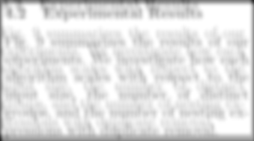
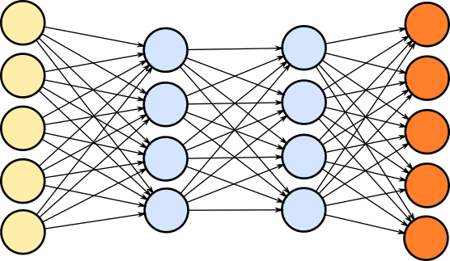
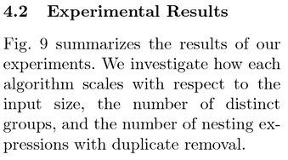
Blind deconvolution with CNNs

Slide 4
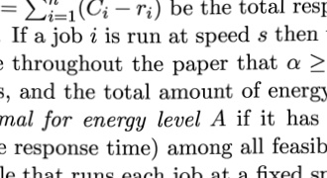
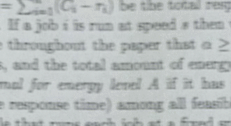
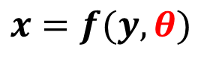
Learn deconvolution function from data
Simulate
space-variant blur, noise, saturation, color aberration, JPEG compression, gamma
Update

Slide 5
CNN in image restoration
Denoising
Jain and Seung: Natural Image Denoising with Convolutional Networks. NIPS 2009.
Structured noise removal
Eigen et al.: Restoring an Image Taken through a Window Covered with Dirt or Rain. ICCV, 2013.
Non-blind deconvolution
Li Xu et al.: Deep Convolutional Neural Network for Image Deconvolution. NIPS 2014.
Super resolution
Dong et al.: Learning a Deep Convolutional Network for Image Super-Resolution. ECCV 2014.
Blind deconvolution (sub-task)
Schuler et al.: Learning to Deblur. CoRR, abs/1406.7, 2014.

Slide 6
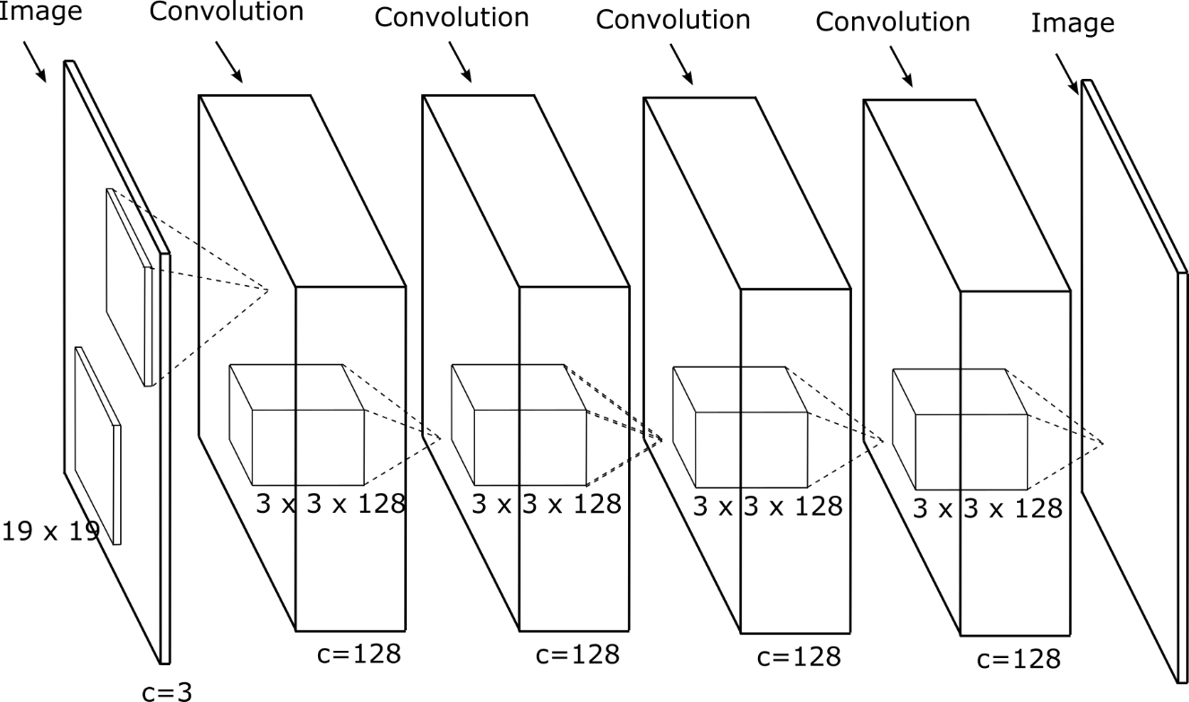
CNN Framework
Based on (Krizhevsky et al., 2012) and many others
Only convolutions and ReLU
Fully convolutional networks
No pooling = output has the same resolution as input

Slide 7
Training
Stochastic Gradient Descent with momentum
Objective = Mean Squared Error
Random weight initialization
Batches of 96 16x16 sharp patches
Good balance between efficiency and variability
Blurred patches are 50x50–70x70 depending on the spatial support of the network
Using modified Caffe framework

Slide 8
Data
50,000 + 2,000 pdf files from CiteSeerX
200,000 + 8,000 rendered pages at 120-150 DPI
3M + 35,000 image regions
Small projective transformations (virtual camera rotations)
Out-of-focus blur (disc)
Camera shake blur (random walk)
Gaussian noise

Slide 9
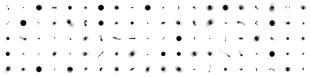
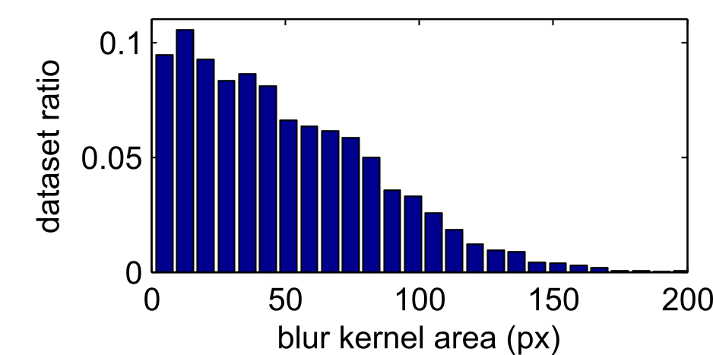
Data
Figure 1: 100 blur filters from test set
Figure 2: distribution of blur-kernel sizes in dataset

Slide 10
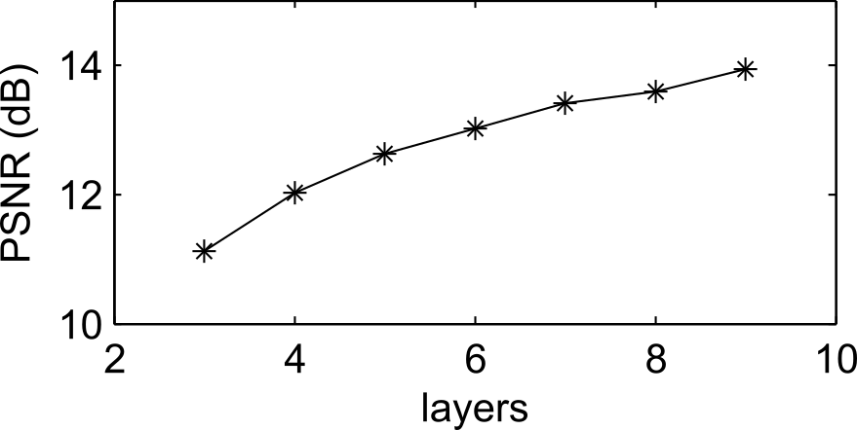
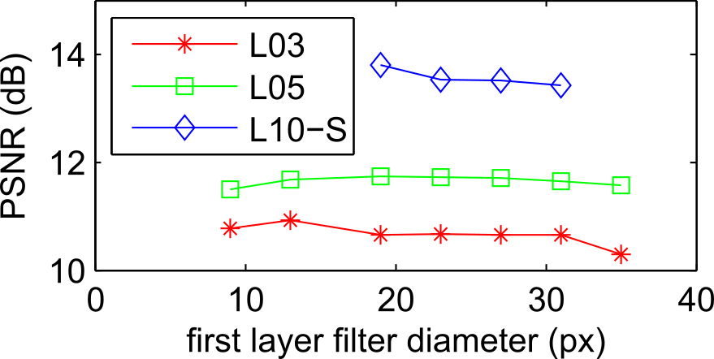
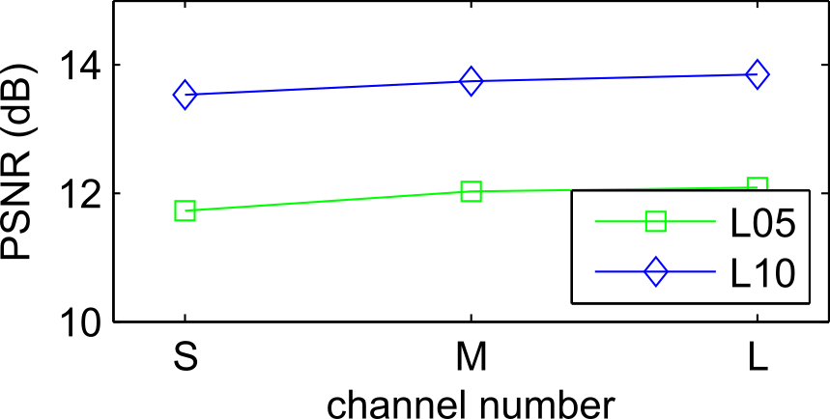
Results
Figure 3: network depth
Figure 4: spatial support size
Figure 5: channel number

Slide 11
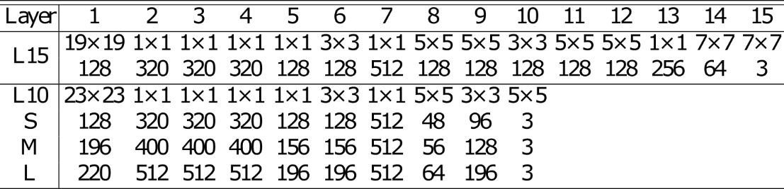
Large CNN
Table 1: CNN architecture – filter size and number of channels for each layer.

Slide 12
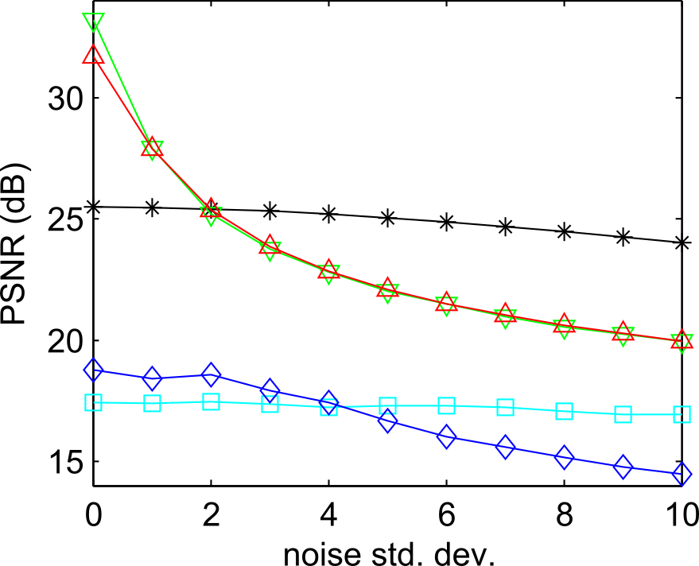
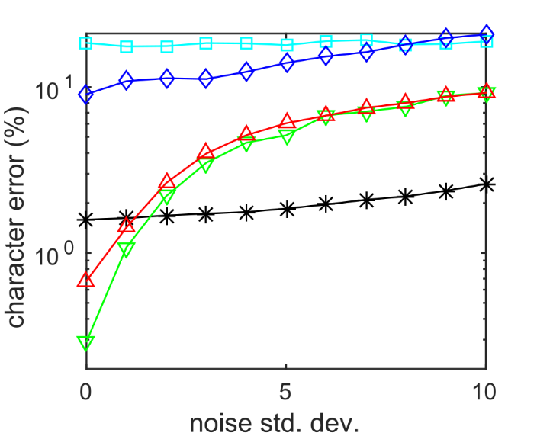
Results - baselines
100 regions each with single random blur kernel
200x200 px – PSNR evaluated on central 160x160 px
2 blind and 2 non-blind baselines – optimized for each noise level

Slide 13
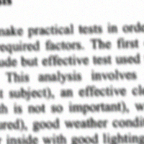
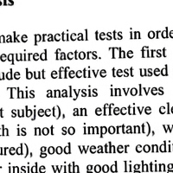
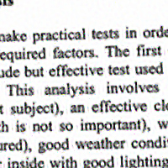
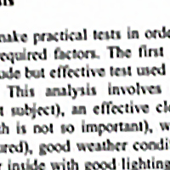
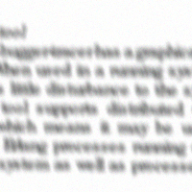
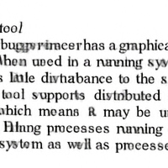
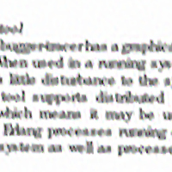
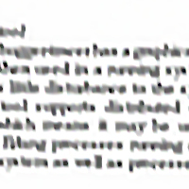
Results - examples
Blurred
CNN-L15
Pan non-blind
Pan blind

Slide 14
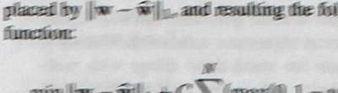
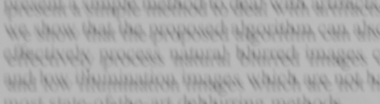

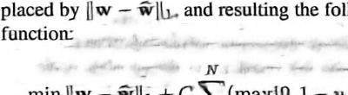
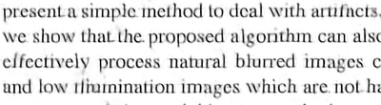
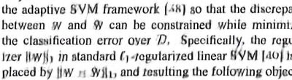
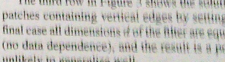
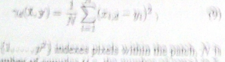
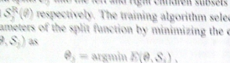
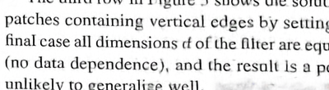
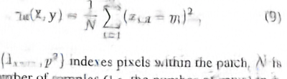
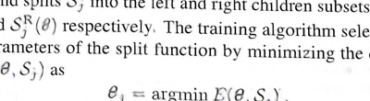
Our results on real images
Photo
CNN
Photo
CNN

Slide 15
Computational efficiency
L15-CNN has ~2.3M weights (9MB)
~ 2.3M multiply and accumulate per pixel
~ 4 Tflop for 1 Mpx image = ~ 2s on high-end GPU
5s in our sub-optimal implementation
1 Mpx image needs 1.3 GB for activations of the largest layers (320 channels)
split the image if this is an issue

Slide 16
Thanks
THANKS

